Slide 1
STN-LIA-MPU
An OLIA spinout development
Development/Discussion LOG
Nikos Chalikias

Slide 2
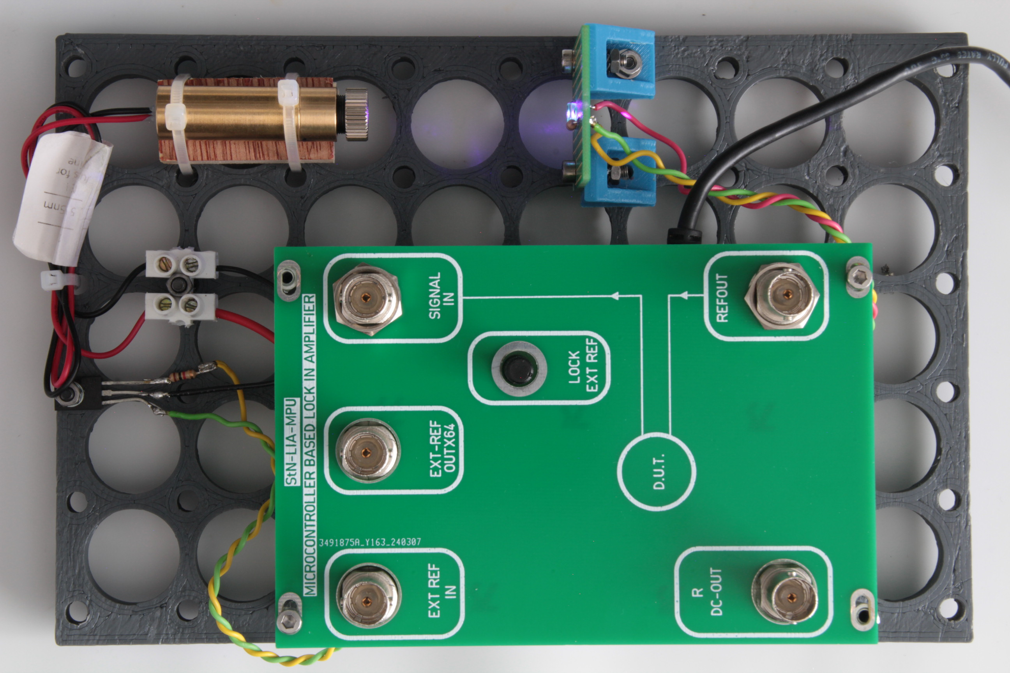
405 nm setup with 1000mW (electric ) power
StN-LIA-MCU with a NPN transistor to drive the 1W laser
BPW34 general purpose Photodiode
We used a 405nm Laser instead an infrared
Output is high: 2000mV (direct laser beam to Photodiode
Can see consistently a 5mV variation when exhale
Will work with similar size/power/lens Infrared Laser
Need for a 2nd Photodiode for liquid tests
It is easier to multiplex and use a 2nd laser, […if this works with the liquid project]

Slide 3
2000nm setup
Proposed to setup a photodiode experiment only with PCBs
This is our goal, but many little details can block the operation for …some time
Chinna proposal: to use existing instrumentation and only PCB LIA (StN-LIA-MCU), seems much better, as a 1st step
Then we can replace:
TEC with PCB (2nd step)
LDD with PCB (3d step)
Generator with PCB (4d step)
Add a microcontroller with LCD/buttons as experiment administrator (5th step)
Add A PC or R-Pi as experiment administrator (6th step)
Evaluate Preamplifier performance
Develop and evaluate, ultra low noise multi-output PSU
This is scalable and sustainable, can start now
2000nm LED and photodiode to be delivered in a couple of days

Slide 4
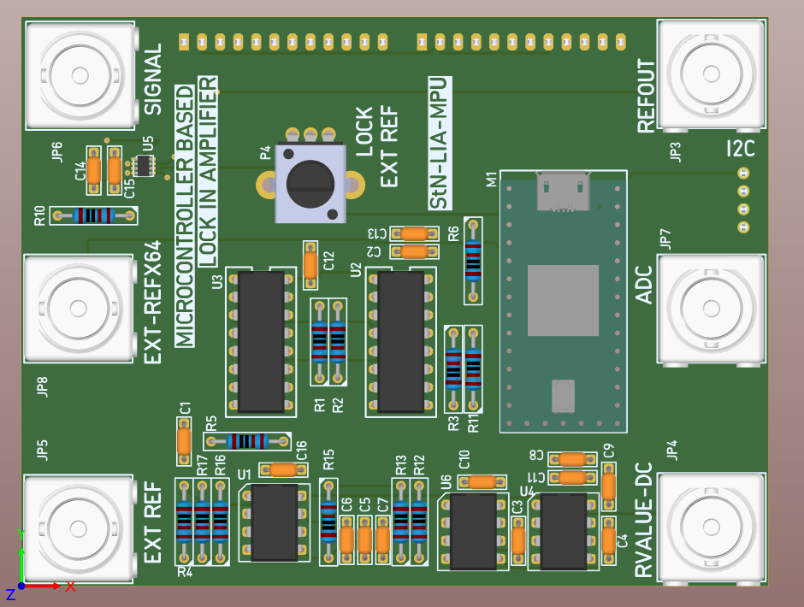
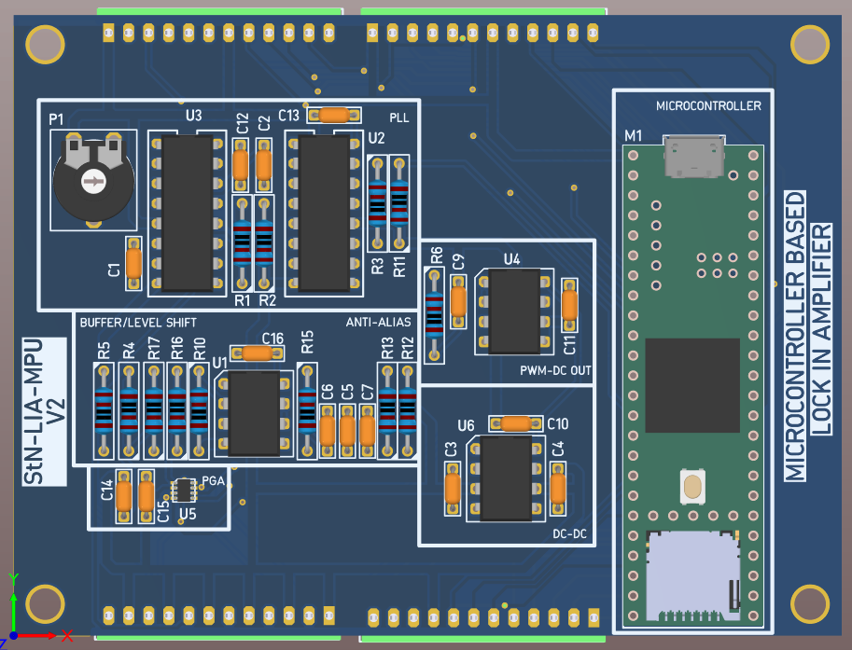
StN-LIA-MCU
V1 ongoing testing, works as expected
A 2nd PCB to be assembled
Most probably the 3d PCB will be V2
V2: Fixed PCB bugs, removed expensive connectors,
Easier to use screw terminals, local SD-Card, lower cost
2 layers PCB faster to be delivered from manufacturer, clean

Slide 5
Plan to assess LIA performance
Started with evaluating Standard Deviation [σ] of the R component DC output of commercial LIA
Already have results for 3 COTS LIA
Propose to expand our evaluation scope with a basic setup for a QTF characterization
Real problem
Experience on the setup
No need for expensive laser or optics
Can work with 0.5 euro 32.768 RTC crystals
No need for Preamplifiers
Can compare with Bari electronics

Slide 6
KNOWN ISSUES
HW and FW is based on OLIA
Works good with internal REFERENCE signal generator but not for all Frequencies
The external REFERENCE frequency is 64X the wanted Frequency, this is confusing for the user
Works well with External REFERENCE at the order of 1KHz, but can’t follow for order of 10KHz
In our FW version we have updated the multiplier ratio to 32X: so it works for 12KHz range
Not any frequency for REFERENCE is working: It has to be an integer fraction of the sampling frequency
Sampling Frequency is 200KHz
We should not have the Integer fraction issue with external REFERENCE, as the sampling rate is (..should) be controlled by the external REFERENCE!!! ….But this not resolved yet…

Slide 7
N2O App4Farm GAS CELL
RUN LIA 2 UNITS AT THE SAME TIME AND SAME REFERENCE
TEST IF COMMON EXTERNAL REFERENCE CREATES 2 REF OUTPUTS AT CONSTANT PHASE DIFFERENCE
BNC ARE NEEDED
IN 2 WEEKS?? YES IT IS POSSIBLE
DRIVE 5V 500mA LED, IS IMPORTANT
USE EXTERNAL PSU FOR THE LED
3+ Boards needed
STATUS
Tested Running 2 GUIs at the same time
3D printing a plastic optics breadboard
To mount/integrate inside a Passepartout enclosure, bottle ouitside

Slide 8
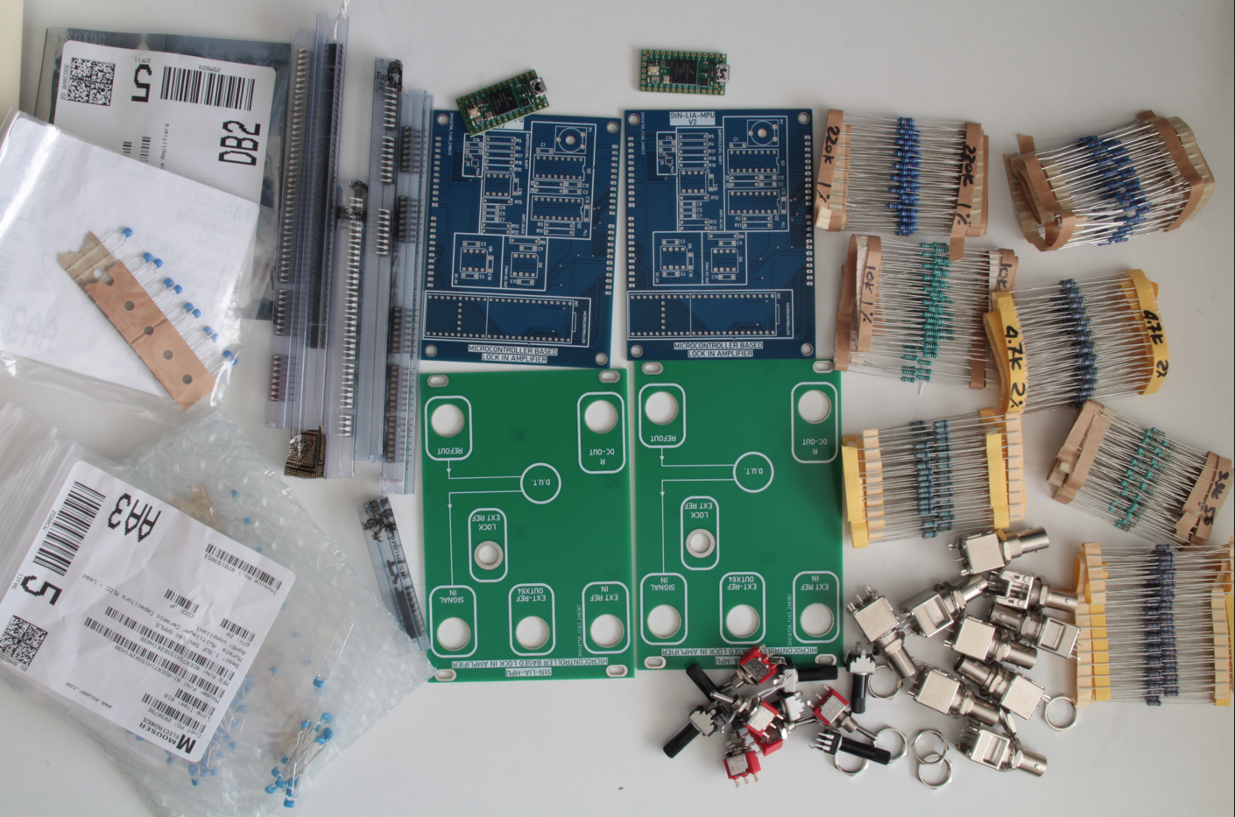
PCBS TO BE SOLDERED

Slide 9
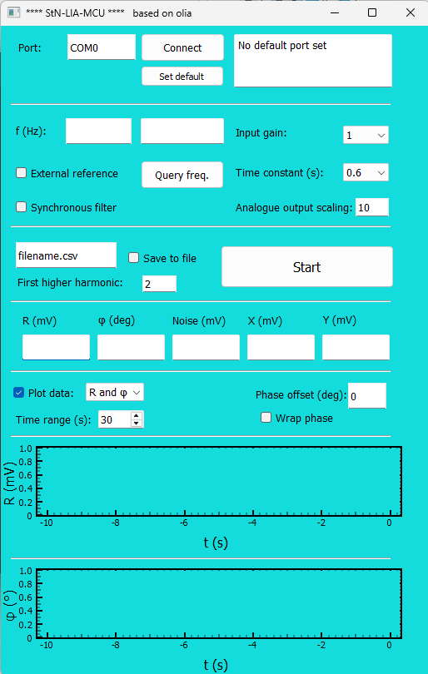
GUI
For our version of GUI: Only minor updates

Slide 10
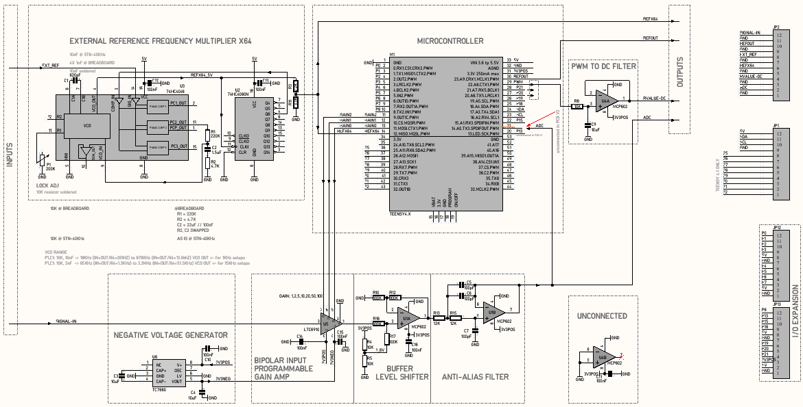
Schematic

Slide 11
Function Calculate() runs every 5μs
Input is sampled 200 times for the 1ms REF period (1KHz)
Sin (0 to 2π) in 200 steps
0 to 199
For 1KHz: 200 samples per REF period
Review of code for 1st harmonic lock-in
OLIA firmware Function calculate() is called periodically every 5μs (200KHz), to
Sample input (ADC)
Calculate the Reference sinusoidal ‘virtual-sample’ (200 samples)
The Reference frequency is: Fsample/A, where A is integer and Fsample is 200KHz
Multiply the input sample with the Reference ‘sample’ and filter
Generate the Rectangular Reference frequency for the D.U.T.
This is in phase with the Internally used sinusoidal Reference

Slide 12
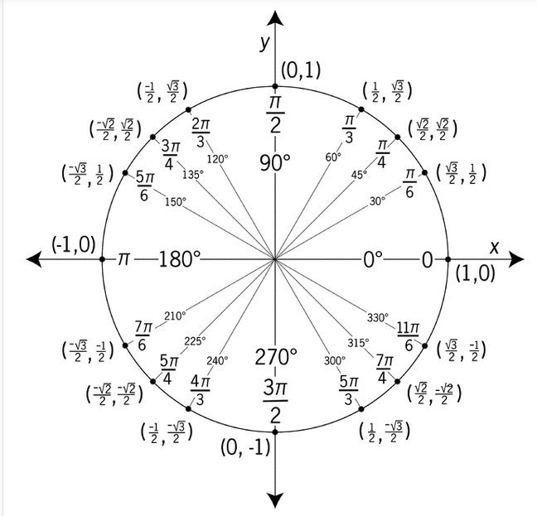
Sinus calculation

Slide 13
Possible upgrades
Main
LIA
ADC0
ADC1
200KHz
Sync the sampling
Use main/aux SNT-LIA-MPU boards with updated firmware
Aux LIA board sampling interrupt is driven from the main
Main outputs the sampling frequency on a new output pin
Aux receives the sampling frequency in a new input pin
Aux sampling interrupt(200KHz) is generated from the input pin, not from internal timer
Sample an external sinusoidal reference
Use a 2nd ADC analogue input pin
Apply external sinusoidal external Reference to the new ADC analogue input
Update the Firmware
Use the external ADC sampled sinusoidal Reference, instead the internally generated
Monitor the internally generated sinusoidal Reference
Add a new DAC chip and connect external oscilloscope for monitoring
Alternatively, export the sinusoidal Reference to a PWM output, without using a new DAC
Update the firmware to export the sinusoidal Reference to DAC, or the PWM output
AUX
LIA
ADC0
ADC1

Slide 14
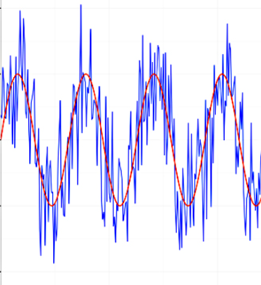
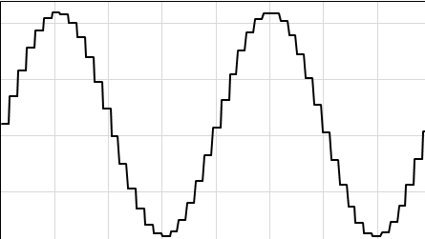
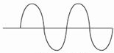
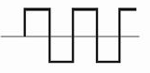
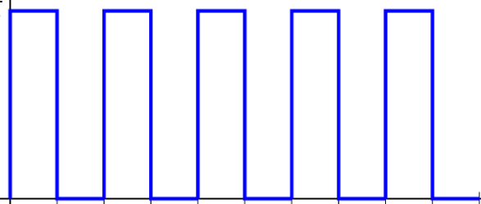
LIA Sampling interrupt: Upgrade for 2nd Input
BLUE=CURRENT
GREEN=UPGRADE
200KHz timer Interrupt (5μs)
Serial port
GUI
GRAPHICAL
USE
INTERFACE
FILTER
Upgraded GUI protocol
INPUT SAMPLE
X
ADC0
DC
Fsample = 200KHz (5μs)
samplesPerPeriod = 200
Reference = 1KHz (1ms)
2nd INPUT SAMPLE
ADC1
Ref=sin(2π* (1->200)/200 )
INTERNAL SINUSOIDAL
REFERENCE GENERATOR
INTERNAL
INTERNAL SINUSOIDAL REF EXPORT
1 KHz
TO OSCILLOSCOPE
SINUSOIDAL REFERENCE ‘VIRTUAL SAMPLES’
SYNCED
DUT
2 OUTPUTS
RECTANGULAR
REFERENCE GENERATOR
100 interrupts HIGH
100 interrupts LOW
1 KHz
200KHz SYNC OUT
200KHz SYNC INT IN

Slide 15
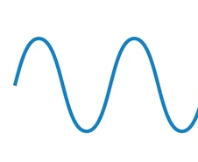
LIA Sampling interrupt: Upgrade for external Reference
BLUE=CURRENT
GREEN=UPGRADE
200KHz timer Interrupt (5μs)
FILTER
Serial port GUI protocol
GUI
GRAPHICAL
USE
INTERFACE
INPUT SAMPLE
X
ADC0
DC
EXTERNAL
ADC1
REFERENCE SAMPLE
Fsample = 200KHz (5μs)
samplesPerPeriod = 200
Reference = 1KHz (1ms)
EXT
REF
Ref=sin(2π* (1->200)/200 )
INTERNAL SINUSOIDAL
REFERENCE GENERATOR
INTERNAL
INTERNAL SINUSOIDAL REF EXPORT
TO OSCILLOSCOPE
SINUSOIDAL REFERENCE
‘VIRTUAL SAMPLES’
1 KHz
SYNCED
D.U.T.
RECTANGULAR
REFERENCE GENERATOR
100 interrupts HIGH
100 interrupts LOW
1 KHz
200KHz SYNC OUT
200KHz SYNC INT IN
To aux LIA
From main LIA

Slide 16
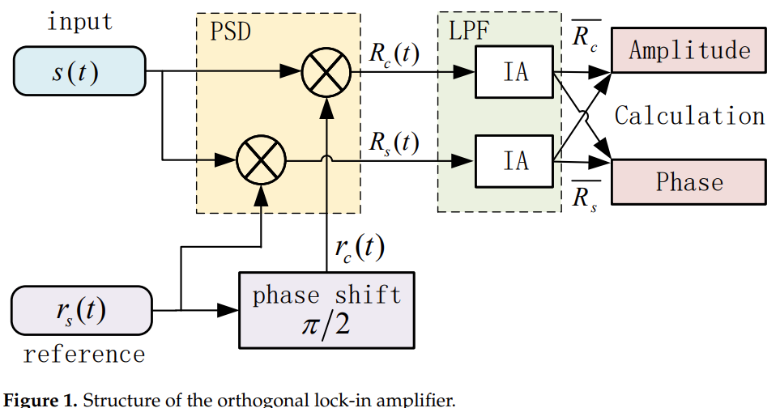
Higher Level Diagram for Orthogonal LIA
Appl. Sci. 2022, 12, 6431

Slide 17
LIA Sampling interrupt, Includes COS : Upgrade for external Reference
BLUE=CURRENT
GREEN=UPGRADE
200KHz timer Interrupt (5μs)
X
FILTER
Serial port GUI protocol
GUI
GRAPHICAL
USE
INTERFACE
INPUT SAMPLE
X
ADC0
DC
EXTERNAL
ADC1
REFERENCE SAMPLE
Fsample = 200KHz (5μs)
samplesPerPeriod = 200
Reference = 1KHz (1ms)
Ref=sin(2π* (1->200)/200 )
INTERNAL SINUSOIDAL
REFERENCE GENERATOR
INTERNAL
EXT
REF
SINUSOIDAL REFERENCE
‘VIRTUAL SAMPLES’
INTERNAL SINUSOIDAL REF EXPORT
COSINE REFERENCE
‘VIRTUAL SAMPLES’
1 KHz
TO OSCILLOSCOPE
INTERNAL COSINE
REFERENCE GENERATOR
SYNCED
D.U.T.
RECTANGULAR
REFERENCE GENERATOR
100 interrupts HIGH
100 interrupts LOW
1 KHz
200KHz SYNC OUT
200KHz SYNC INT IN
To aux LIA
From main LIA

Slide 18
LIA Sampling interrupt, with cos and circular buffer: Upgrade for external Reference
BLUE=CURRENT
GREEN=UPGRADE
200KHz μC timer Interrupt (5μs)
X
Y
FILTER
SAMPLED
RESULTS
POST
PROCESS
INPUT SAMPLE
X
Χ
Χ,Y
X,Y,R,φ,N => Serial port GUI protocol
ADC0
EXTERNAL
ADC1
CIRC
BUFFER
SIN
REFERENCE SAMPLE
COS
Fsample = 200KHz (5μs)
samplesPerPeriod = 200
Reference = 1KHz (1ms)
VALUE 0 TO 1
INTERNAL SINUSOIDAL
REFERENCE GENERATOR
INTERNAL
EXT
REF
SINUSOID REFERENCE
‘VIRTUAL SAMPLES’
Ref=sin(2π* (1->200)/200 )
VALUE 0 TO 1
INTERNAL COSINE
REFERENCE GENERATOR
INTERNAL
COSINE REFERENCE
‘VIRTUAL SAMPLES’
Ref=Cos(2π* (1->200)/200 )
SYNCED
D.U.T.
RECTANGULAR
REFERENCE GENERATOR
100 interrupts HIGH
100 interrupts LOW
1 KHz
200KHz Sampling SYNC Input
200KHz SYNC OUT
To aux LIA
Ext Generator
Or Other LIA

Slide 19
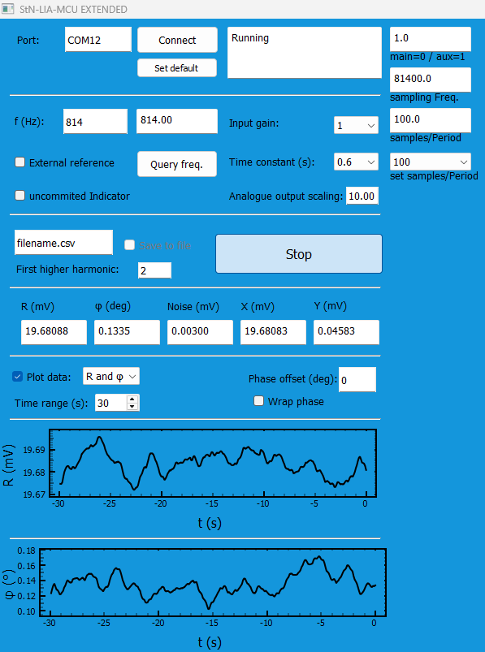
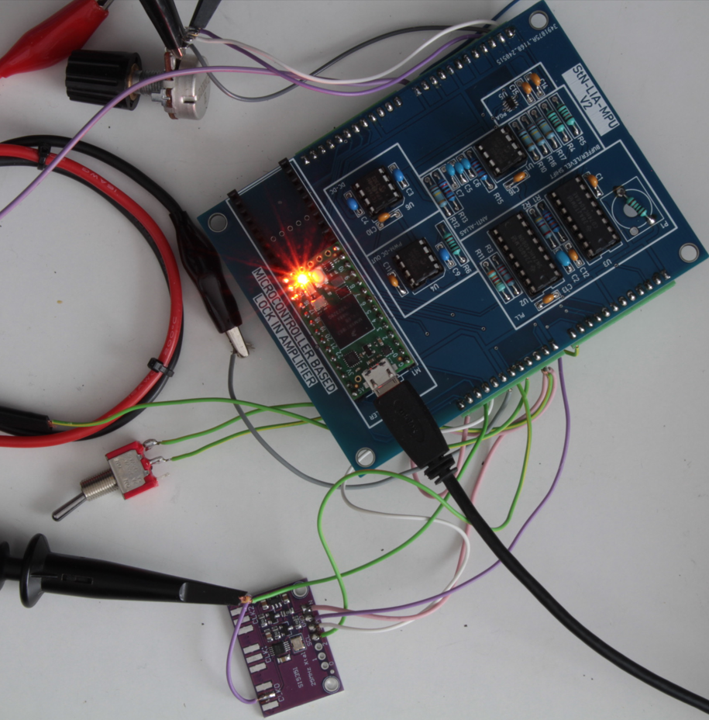
EXTENDED FUNCTIONALITY

Slide 20
StN-LIA-E: Extended Functionality
STN-LIA-MPU
aux mode
Sampling Interrupt
1KHz
D.U.T.
GENERATOR
New
ADC
samplesPerPeriod
200
GUI
Updated
200 000
I2C
Or
Human Operator
Frequency
Control
1000
Reference Frequency
Sampling
Frequency

Slide 21
StN-LIA-E: Two Synchronized Lock In Amplifiers
STN-LIA-MPU aux Mode
STN-LIA-MPU main Mode
Sampling Interrupt
from Internal timer
ADC
1KHz
D.U.T.
2 OUTPUTS
Sampling Interrupt
from external sync Input
ADC
Timer interrupt
Sampling
Frequency
Samples
Per Period
200
200
Timer
200 000
GUI
200 000
1000
GUI
1000
Reference
Frequency

Slide 22
LIA Sampling interrupt, Control with external Precise generator
Any Frequency, including QEPAS resolution
Precise [0.0001Hz] Frequency Resolution (0.01Hz / 100)
Can be used as External Generator for a Bench Lock In Amplifier
Synchronized operation of multiple STN-LIAs [solves UCC setup]
With a small addition the PCB setup can produce sinusoid output in the audio Freq Range

Slide 23
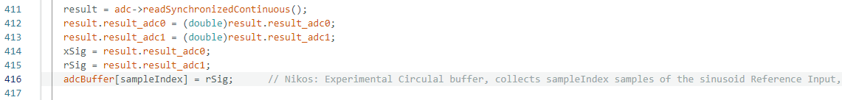
Synced Input ADC channels and Circular Buffer
Synchronized reading of 2 ADC channels and circular buffer for the Reference
[0 to 199] for 1KHz and Sampling rate 200 KHz
The circular buffer for the sinusoid Reference signal Input, is used to create the Cosine of the Reference

Slide 24
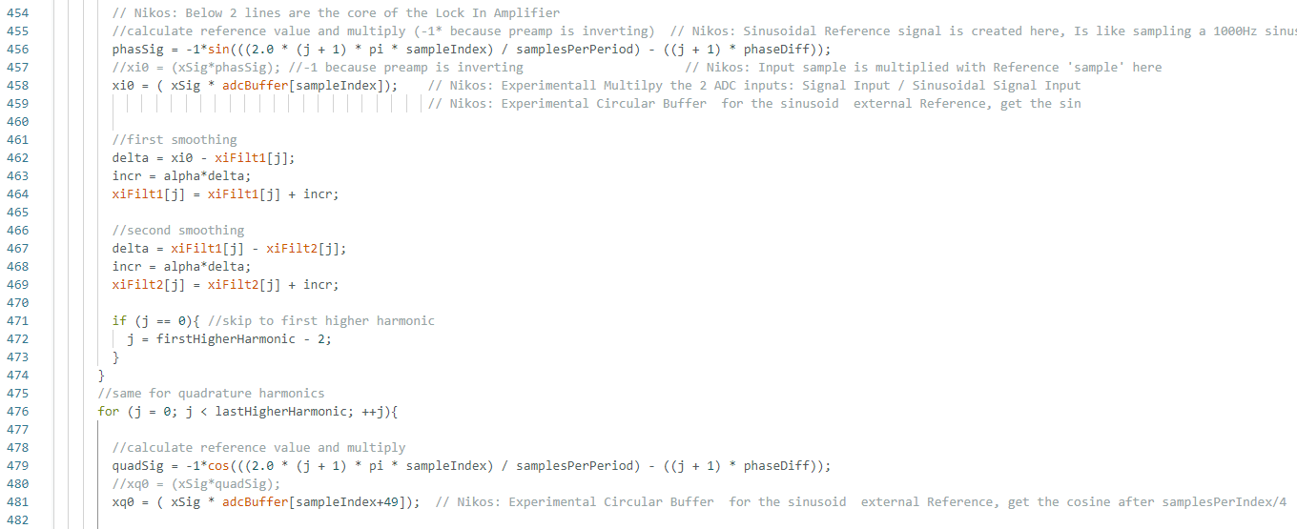
Sin and Cos implementation in C++
SIN (in phase harmonic)
1*π
COS (quadrature harmonic)
Cosine is 1π (200/4 for 1KHz) later in the Circular Buffer

Slide 25
Requirements discussion
We're looking for two signal channels driven by a single modulation source, ideally produced by the LIA, to modulate a single LED.
From the LED, we get two signals by splitting the light into two separate channels that are individually detected after the light passes through the sample. These need to be separately lockin amplified.
We would ideally want to get a sensitive measurement of the channels individually, or maybe just the ratio of the channels if that was more sensitive and could be determined directly.
I think this means:
one modulation source (in the LIA)
two input channels
lockin signal processing for two channels . It might be possible to do the two channels from the same op amp etc., but maybe not.
After 31/12/2024 call
Must measure 2 outputs from the D.U.T. in parallel
Implementation with 2 LIA boards that use external reference
Implementation with 2 signal inputs on the same LIA board, with internal reference
Lower priority: Calibrate by measuring the PHASE Φ, at different frequencies1KHz to 10KHz

Slide 26
UCC Requirements discussion: 31/12/2024 call
After 31/12/2024 call
Must measure in parallel, 2 outputs from the D.U.T.
Implementation with 2 LIA boards that use external reference
This option does not need extensive GUI updates
Implementation with 2 signal inputs on the same LIA board, uses only internal reference
Need major rework for the GUI
Lower priority: Calibrate by measuring the PHASE φ, at different frequencies1KHz to 10KHz

Slide 27
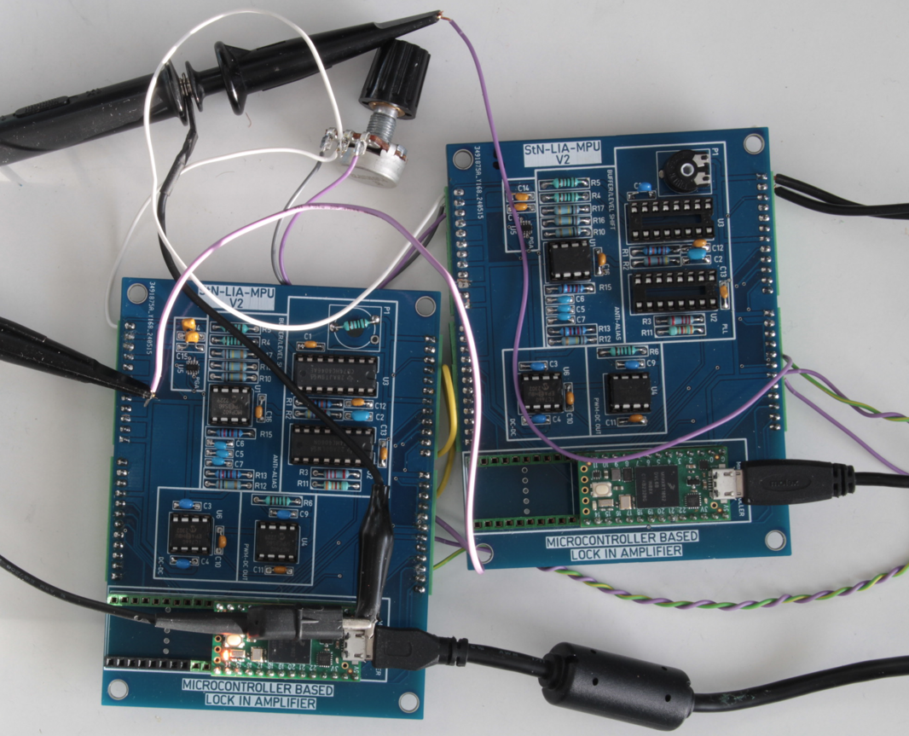
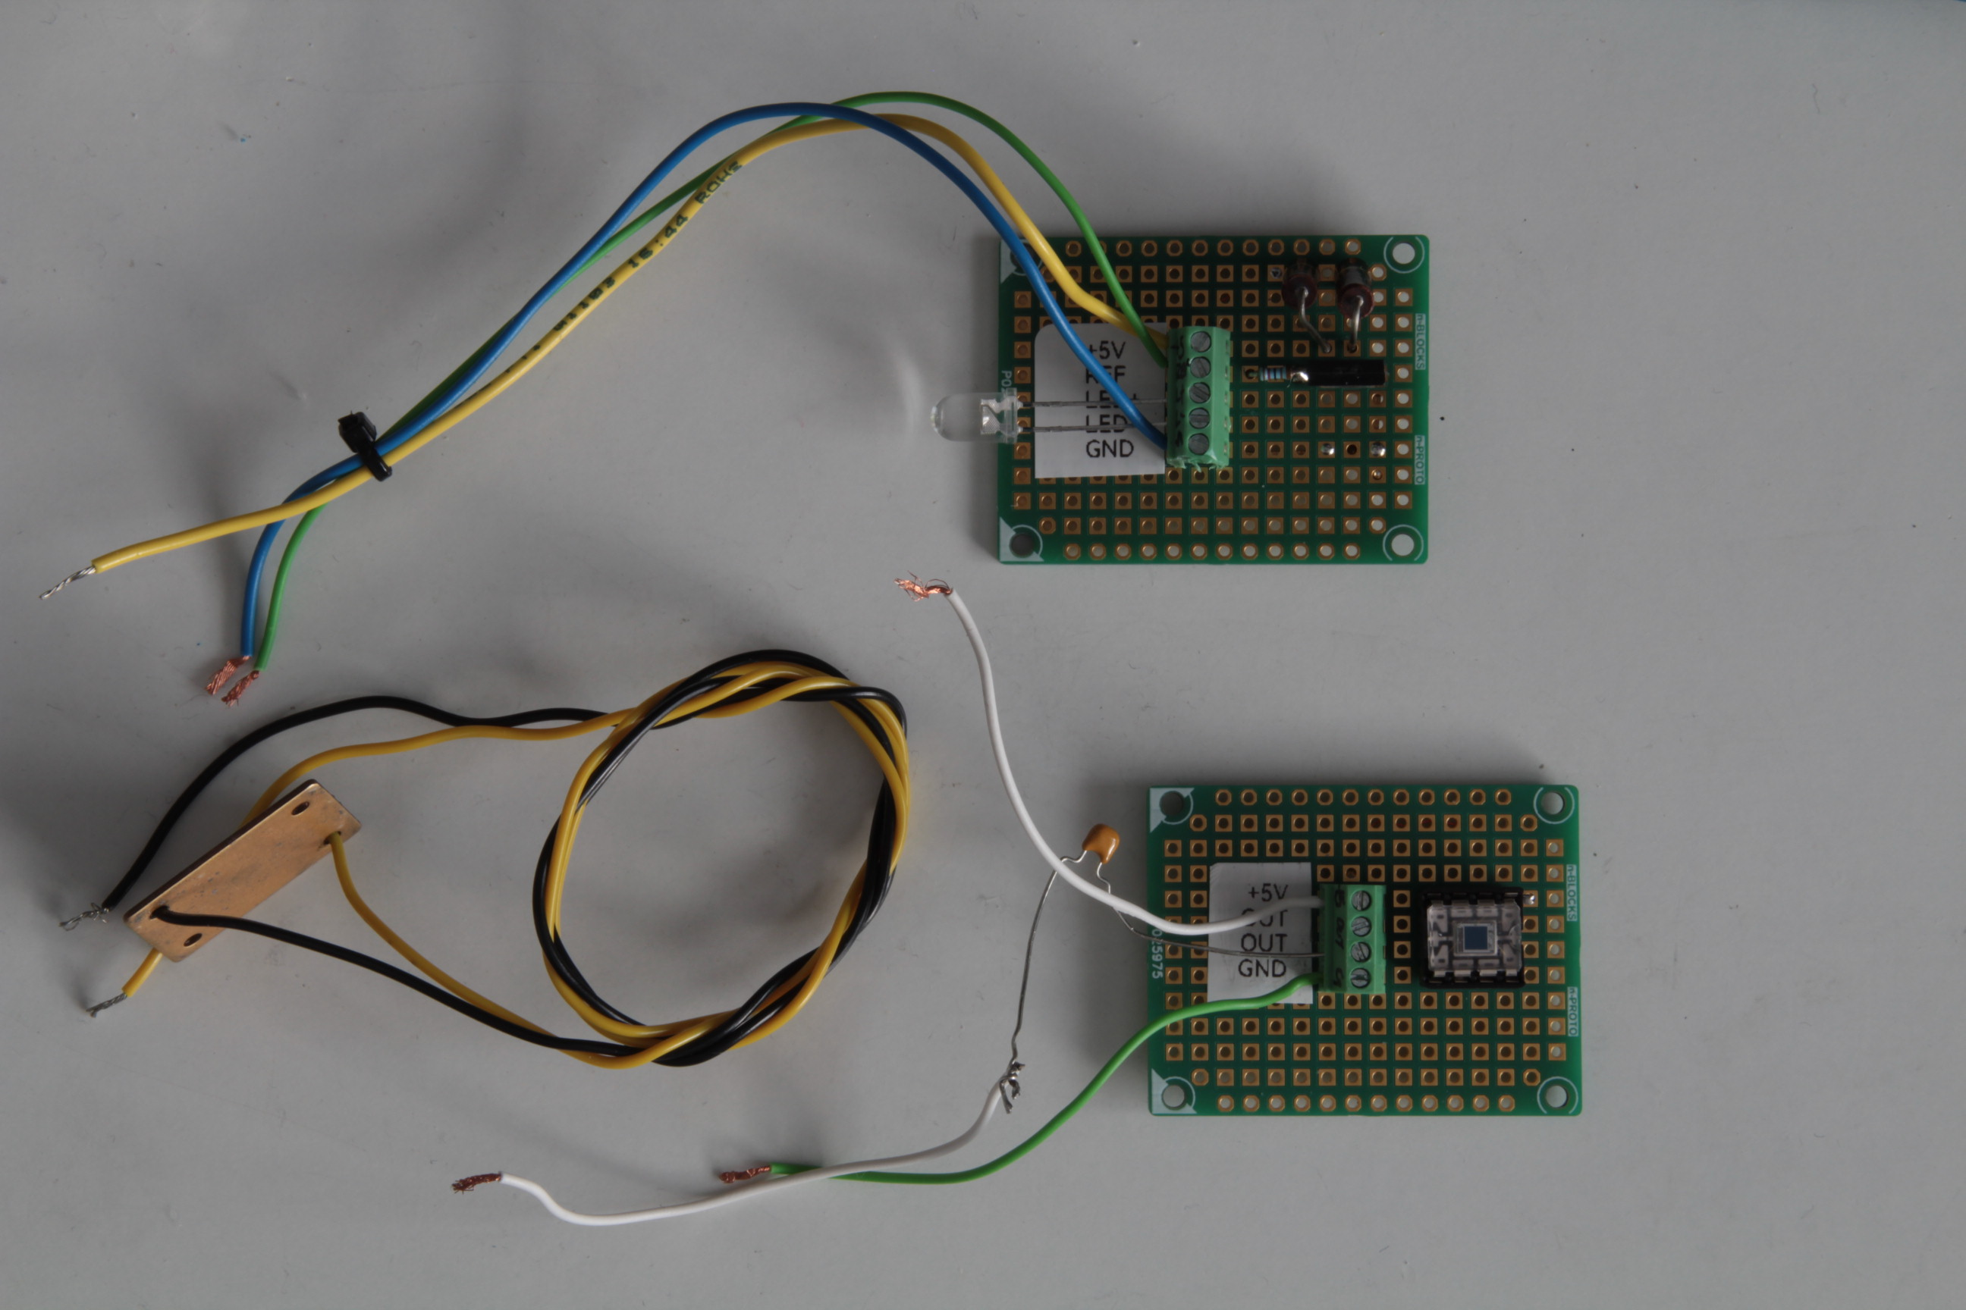
Two PCBs tested in synchronization
Both PCBs have the same signal input (Potentiometer adjusted to 16mV)
The Reference signal is created from the main PCB and drives to Potentiometer
OPT101 and LED removed to avoid ambient light interference with the signal
aux LED is ON

Slide 28
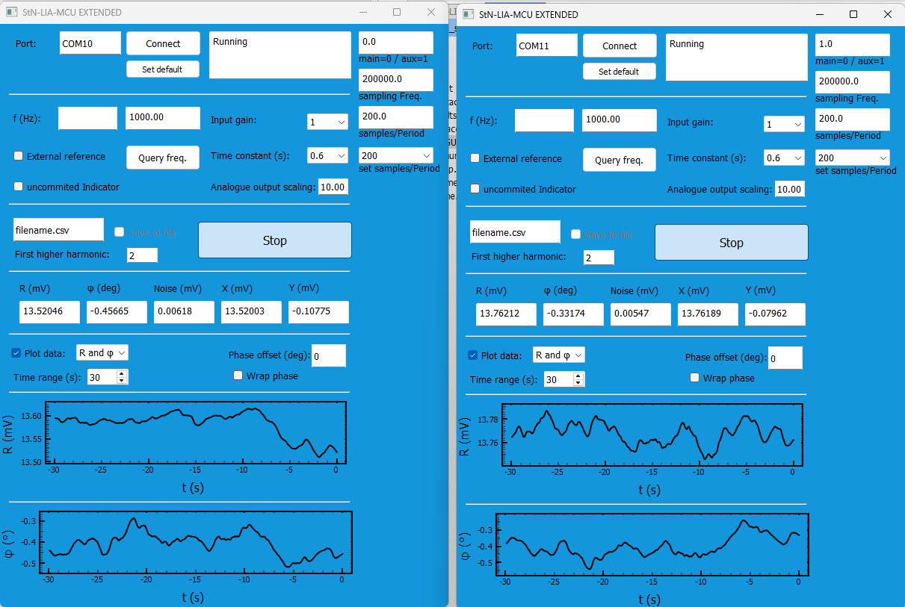
Two PCBs tested in synchronization
Do we need R calibration Offset (13.762mV -13.52046mV here),
So R appears exactly the same for a common input?
It would appear similar to the
Phase offset BOX

Slide 29
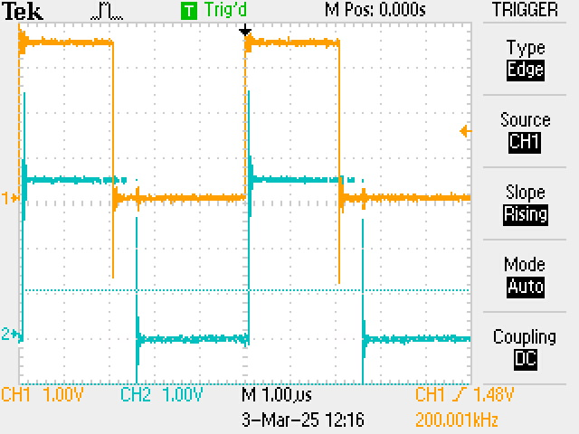
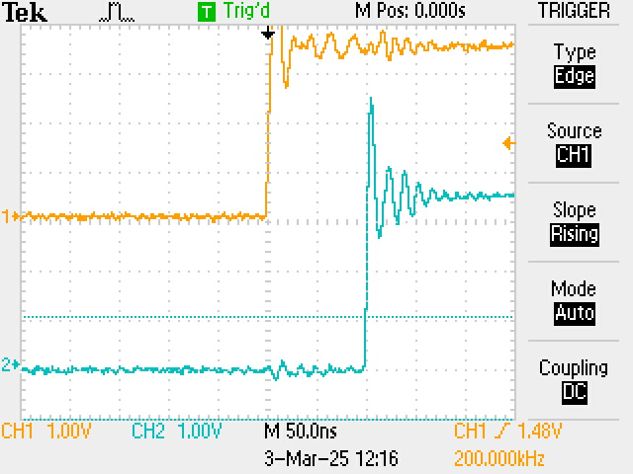
Two PCBs tested in synchronization
main PCB sync out
drives aux PCB
aux PCB sync out
The 2 PCBs are synchronized
The aux PCB interrupt (sampling) has 100ns delay
The phase difference between the main and aux sampling is stable (100ns)

Slide 30
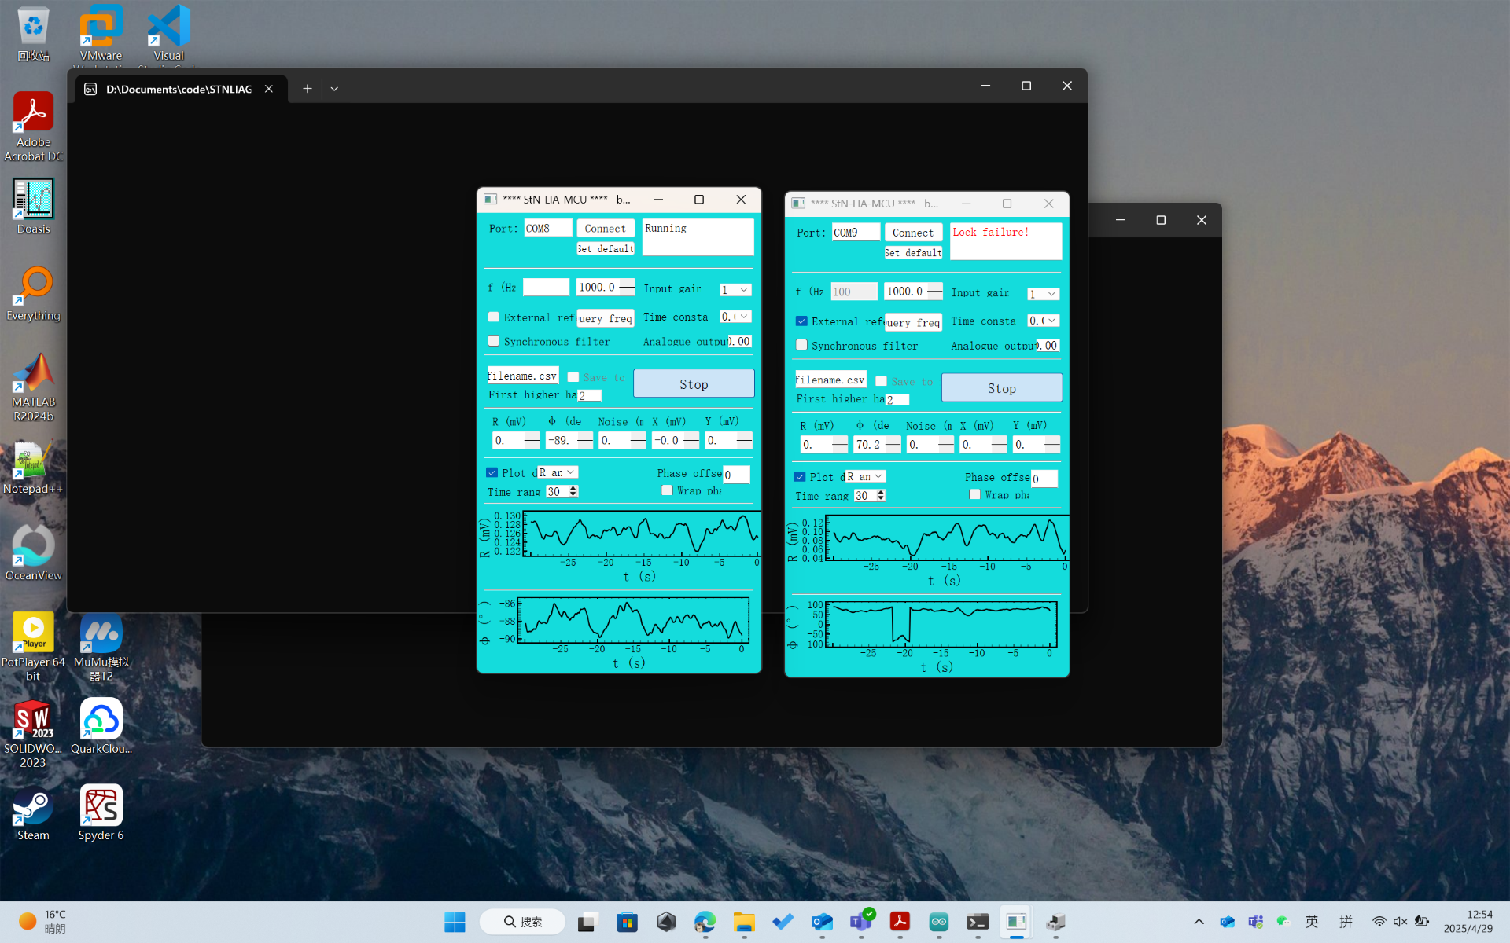
WRONG SETUP
SETUP as reported at 29 April 2025:
main (left)Board runs new firmware
aux board (right, aka upper) runs old Firmware
Running 2 instances of the OLD GUI
The visible results
“Lock Failure” message
R, Theta on right board seems inconsistent with very low values
Nikos notes:
The setup is obviously wrong!
Slide 20 (StN-LIA-E: Two Synchronized Lock In Amplifiers) thick RED ARROW is not implemented with old firmware
The [right, upper] aux board is not synchronized, as per slides 20,21,27,28,29
main board
aux board

Slide 31
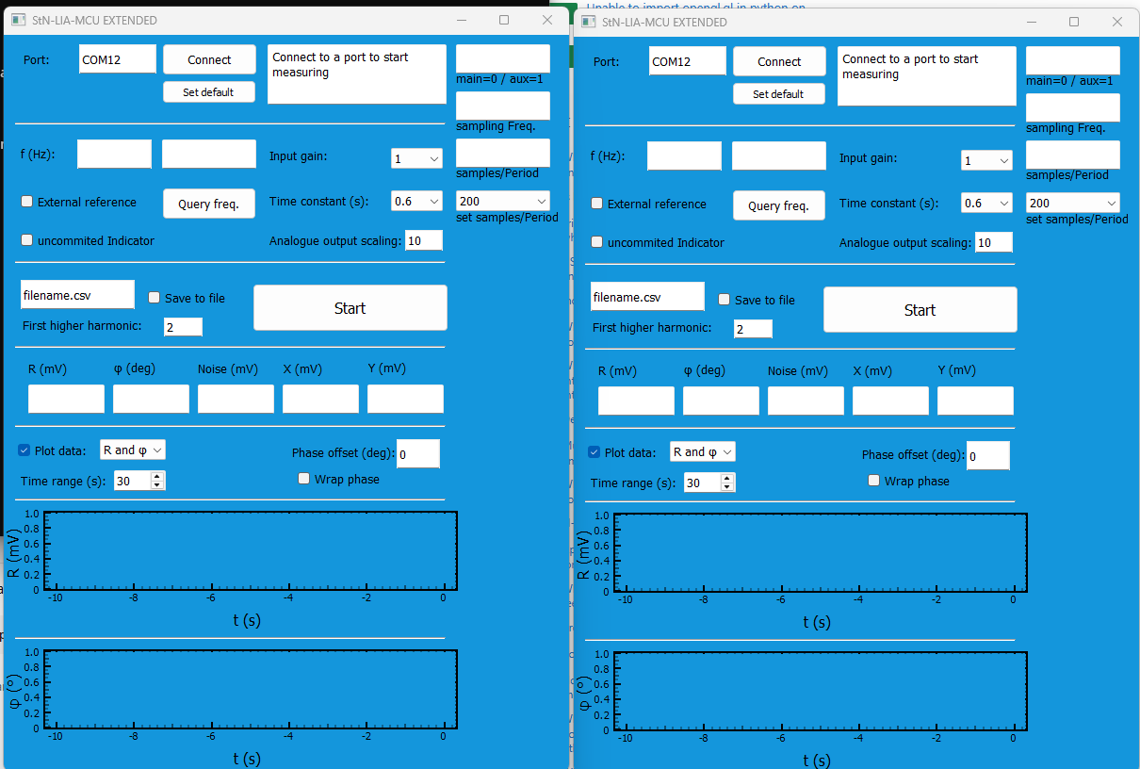
new GUI (unconnected to boards)
SETUP as reported at 29 April 2025:
main (left)Board runs new firmware
aux board (right, aka upper) runs old Firmware
Running 2 instances of the OLD GUI
The visible results
“Lock Failure” message
R, Theta on right board seems inconsistent with very low values
Nikos notes:
The setup is obviously wrong!
Slide 20 (StN-LIA-E: Two Synchronized Lock In Amplifiers) thick RED ARROW is not implemented with old firmware
The [right, upper] aux board is not synchronized, as per slides 20,21,27,28,29
main board
aux board

Slide 32
OPT101 SETUP
Expand with
2nd OPT101 PCB
2nd LED ???

Slide 33
QUESTIONS

